Slide 1
Software Engineering
Mohsen Amini Salehi

Slide 2
Introduction
Mohsen Amini Salehi
Born in 1980
Associate Professor
Prof at UL Lafayette from 2014 — 2023
Professor at UNT from 2023 — Now!
PhD from Melbourne University, Australia (2008-2012)
Director of the High Performance Cloud Computing (HPCC) lab.
Research interests:
Distributed and Cloud Computing

Slide 3

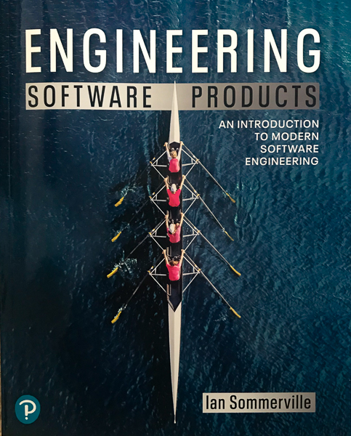
Introducing the Course: Text Books
Course Title:
Software Engineering
Reference Book:
Software Engineering (Edition 10)
Author: Ian Sommerville
Engineering Software Products
Author: Ian Sommerville
Other online resources
Chapter 1 Introduction
3

Slide 4
Introducing the Course
Recent research papers as another source for the class
This is a practical course!
Office Hours:
Office
Thursdays 3:30 – 5:30pm
Contact beforehand if the question will take more than 10min!
Email
24/7
mohsen.aminisalehi@louisiana.edu
Chapter 1 Introduction
4

Slide 5
Introducing the Course
I upload slides, samples, etc. through Canvas
TAs:
TA Name | In-person office hours | Online office hours | Contact
Minseo Kim | Mon. 12:00 to 2:00pm | Wed 10:00am to 12:00 pm (link) | minseokim@my.unt.edu
Akiharu Esashi | Wed.12:00 to 2:00pm | Thur 12:00pm to 2:00pm (link) | akiharuesashi@my.unt.edu
Amina Firdouse | Fri. 2:00 to 4:00pm | Tues 2:00 to 4:00pm (link) | aminafirdousefirdouse@my.unt.edu
5

Slide 6
Course Plan
Group-based Projects/Assignments
Groups of 5—8 students (start today!)
60% of the final grade
Assignments can also be submitted within 24 hours after the due date unless otherwise advised (with 20% penalty!)
Assignments will be announced through Canvas
Just one week time to question any grade!
Bonus point for extra class/assignment activities
Chapter 1 Introduction
6

Slide 7
Course Plan
Midterm and Final Exams
In total 40% of the final grade
ODS students should do the appropriate arrangements
Grading standard
A: 90-100
B: 80-89
C: 70-79
D: 60-69
F: 0-59
Chapter 1 Introduction
7

Slide 8
Academic Honesty
Academic honesty is expected from all students in the class
Any cheating and/or plagiarism will be treated based on the University academic honesty policy
First violation zero in that activity; second violation F for the course and report to the University

Slide 9
Collaboration: A Tricky Issue!
It is encouraged! if it means: discussing the problem and solution with others
It is STRICTLY prohibited if it means: inclusion of any code/text in the program/document that was not done by yourself!
This is in fact called cheating!
Complete the integrity quiz on Canvas TODAY!
Please include either of the following statements at the beginning of any assignment report :
I certify this assignment is completely done by myself. However, I received help in the following senses. Explain the help here…

Slide 10
Attendance
Taking part in the classes is encouraged but not compulsory!
However:
Students are responsible for all missed works, or any announcements in the class
The absence reason could be anything (including) university sponsored events

Slide 11
Course Goal
My belief:
For the major part, Software Engineering organizes things you already know
Formalizes what we had been doing awkwardly!
Understanding with the software lifecycle
Obtaining the knowledge of software engineering for various scales and domains
Learning responsibilities & ethics of a software engineer
Ability to design a software
Don’t forget: All companies are software companies!

Slide 12

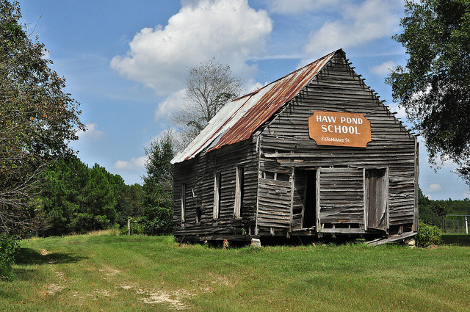
Course Goal

Slide 13
Activities During this Course
Take part in the Academic Integrity quiz on Canvas
Form your group
Choose your project topic
Perform requirement engineering and design
Develop the project
Test and deploy

Slide 14
Roadmap
Evolution of Software Engineering Approaches
Requirement Engineering
Software Design
Testing
Software Evolution
Cloud-based software deployment
Dependability and Security
Reusability and version management
SOA
Project Management

Slide 15
Software Engineering: A Retrospective View
Software “Engineering” emerged in 1960s
As part of Apollo project the essence of SE was felt
People were impressed by hardware development at that time
Software had to be designed for the specific hardware
Margaret Hamilton, a lead engineer on Apollo program, responsible for on-board software development used the term around 1966.
In 1968,the first conference on software engineering was held, sponsored by NATO.
A discipline was born.
The phased model of developing hardware was used as a basis for the so-called software life cycle model

Slide 16
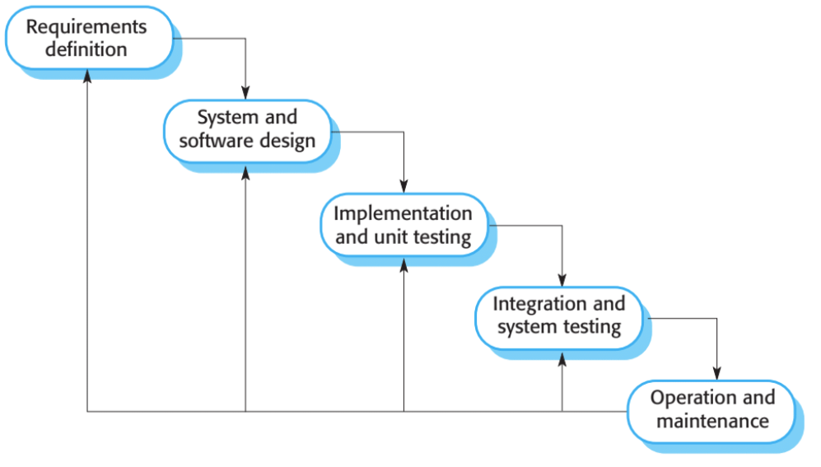
The software lifecycle: waterfall model!
This approach is hardware-inspired, however, software is more malleable!
It can be changed during the development and after that
Softwares can be developed in increments

Slide 17
Software Development Ecosystem
Waterfall does not prescribe any software tool
However, over time many software tools emerged around this dominant software engineering paradigm
Structured programming in high-level languages (1960)
Graphical system modelling (1990)
Object-oriented development (1960 came back in 90’s)
Programming environments (1970)
Parallel programming (practically in 80’s)
Application program interfaces (API’s) (1990)

Slide 18
Conventional Software Engineering
In conventional Software Engineering:
The customer has a problem
He/She specifies the characteristics of the software to be developed (software requirements)
Changes to the requirements are suggested by the customer and must be agreed with the developing company
Waterfall better fits software engineering, whereas agile fits to software products better

Slide 19
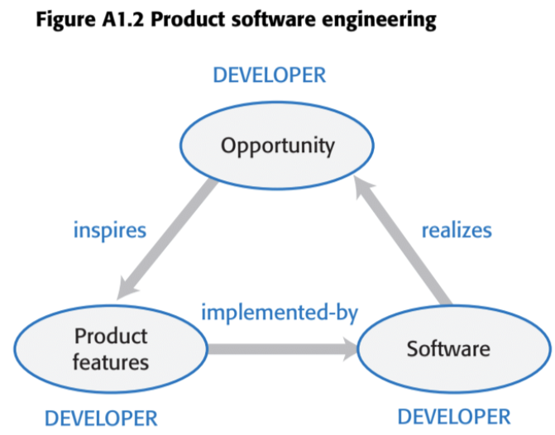
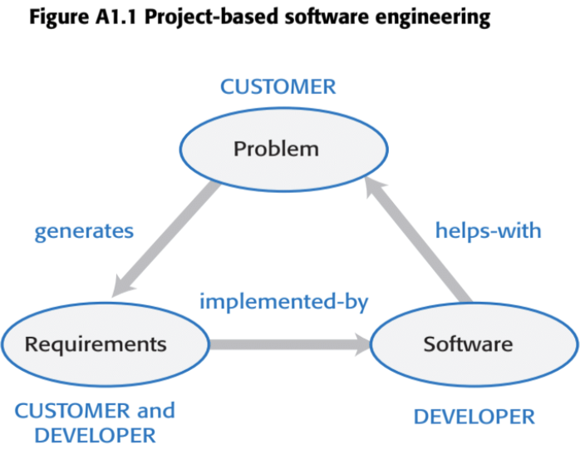
Software Product vs Software System Engineering
SE designed to support the business activities of the purchaser of the software system
Aka project-based software engineering
A customer is involved in software systems engineering
A paradigm shift in Software Industry:
Software product engineering is by far the biggest sector of the software market today!

Slide 20
Software Product vs Software System Engineering
Both software products and systems have a long lifetime
Example: banking systems and Ms. Excel (1985)
Software systems still use the same code
Because owner should decide for the change
The non-tech owners generally do not understand when the software change is needed!
Sometimes they change the same system, and it becomes even more difficult to understand and maintain!
Software products, however, rarely use the same code
They update more frequently

